Slide 1
5.1 Quality diagnostics in JD+
ESTP training

Slide 2
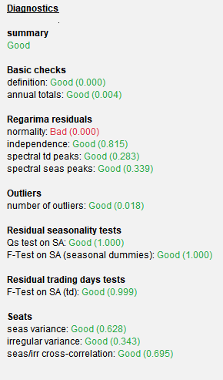
1. Possible outcomes
Value | Meaning
Undefined | The quality is undefined: unprocessed test, meaningless test, failure in the computation of the test...
Error | There is an error in the results. The processing should be rejected (for instance, it contains aberrant values or some numerical constraints are not fulfilled
Severe | There is no logical error in the results, but they should not be accepted for some statistical reasons
Bad | The quality of the results is bad, following a specific criterion, but there is no actual error and the results could be used.
Uncertain | The result of the test is uncertain. Consider it with caution
Good | The result of the test is good

Slide 3
1.1 Computation of the global indicator (summary)
Sum | Rules
Undefined | All diagnostics are Undefined
Error | There is at least 1 error
Severe | There is at least 1 "severe" diagnostic but no error
Bad | No error, no severe diagnostics; the average of the (defined) diagnostics (Bad=1, Uncertain=2, Good=3) is < 1.5
Uncertain | No error, no severe diagnostics; the average of the (defined) diagnostics (Bad=1, Uncertain=2, Good=3) is in [1.5, 2.5[
Good | No error, no severe diagnostics; the average of the (defined) diagnostics (Bad=1, Uncertain=2, Good=3) is ≥ 2.5
In most cases, we can’t say that one seasonal adjustment is « better » than another one → NO FIGURE
We even can’t say that a SA is really good
We just can say that there is probably a problem in a given SA (or not)

Slide 4
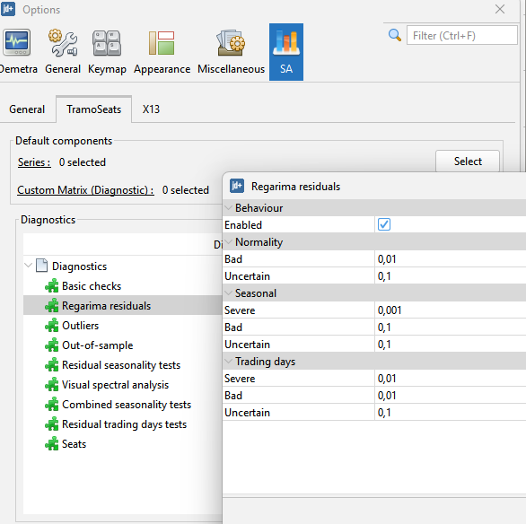
2. Customization of the diagnostics
Diagnostics can be enabled/disabled
Thresholds can be modified
Different diagnostics following the algorithm (new in v3)

Slide 5
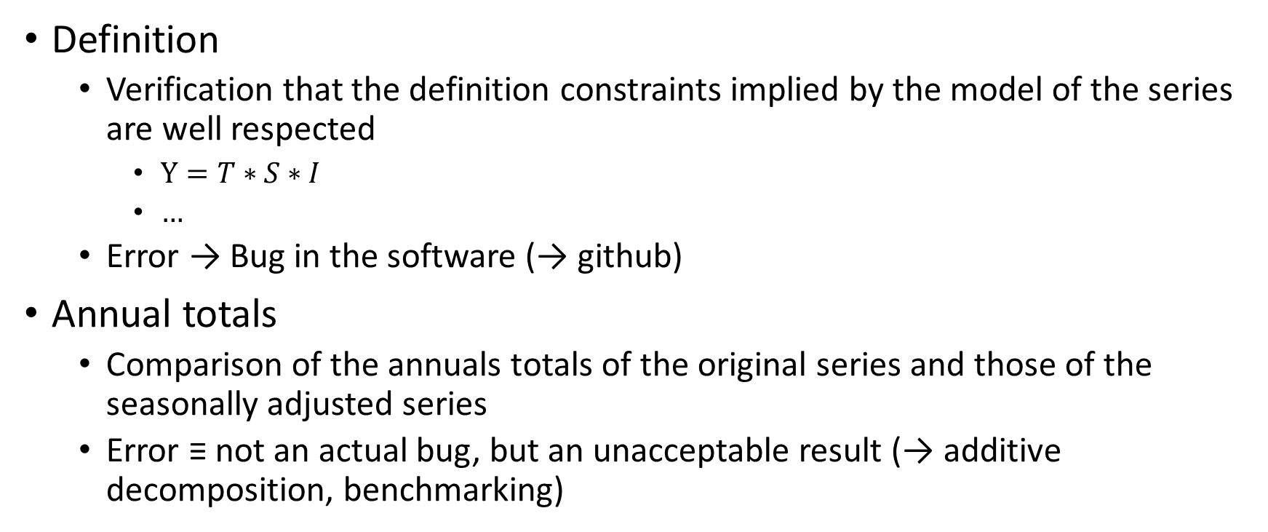
3.1 Basic checks
Definition
Verification that the definition constraints implied by the model of the series are well respected
$Y=T∗S∗I$
$…$
Error → Bug in the software (→ github)
Annual totals
Comparison of the annuals totals of the original series and those of the seasonally adjusted series
Error ≡ not an actual bug, but an unacceptable result (→ additive decomposition, benchmarking)

Slide 6
3.21 Modeling: REGARIMA residuals
Various NIID tests on the residuals of the REGARIMA pre-processing.
Normality (Doornik-Hansen)
Independence (Ljung-Box)
Spectral TD (periodogram).
Spectral Seas (periodogram)
Should not be overstated
especially normality, independence
especially for X12
Show possible problems in the decomposition part.

Slide 7
3.22 Modeling: Outliers, out-of-sample diagnostics
Should we accept a series with many outliers ?
Should we accept a model that provides biased/bad forecasts (mean/variance) at the end of the series ?
Not enabled by default, but used for model selection in Tramo (AMI)

Slide 8
3.31 Residual seasonality tests
Most important test
Qs test and F-test on seasonal dummies (last 12 years)
On the SA series and on the irregular component (sufficiently large)

Slide 9
3.32 Combined seasonality tests [TODO]
X12-like
Seasonality tests on SA, I
Computed on the whole series, on the last 3 years

Slide 10
3.4 Residual trading days tests
Disabled for quarterly series, rather important for monthly series
F-test on trading days variables
On the SA series

Slide 11
3.51 Seats diagnostics
Model-based diagnostics
Comparison of the variances of the theoretical estimators of the (stationary) components (seasonal, irregular) and of their estimates
More detailed information available in the interactive module (not used in the diagnostics)
Possible problems when
The ARIMA model is changed by SEATS
The chosen ARIMA model doesn’t fit correctly the data (see also ARIMA residuals)

Slide 12
3.52 X11 Diagnostics
M-Statistics: global indicators (see Ladiray-Quenneville…)
Q
Q-M2

